Slide 1
Diabetes
What Raises and Lowers Your Blood Sugar Level?

Slide 2
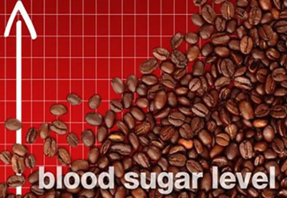
Upswing: Caffeine
There are many different ways that blood sugar (glucose levels in the blood) can be affected and may cause problems with sugar control in people with diabetes. Each person reacts differently to a variety of things that influence blood sugar. People with diabetes should be aware of certain compounds and activities that influence blood sugar levels.
One of these compounds is caffeine. Blood sugar levels can rise after drinking coffee, black tea, and caffeinated energy because of their caffeine content. Read on to learn more compounds that may alter blood glucose levels, along with methods people with diabetes can use to see what substances and behaviors influence their own blood sugar levels.

Slide 3
Upswing: Sugar-Free Foods
پA number of foods claim to be "sugar-free." But these foods may still raise blood sugar levels because many contain carbohydrates in the form of starch or fiber. Sugar alcohols such as sorbitol and xylitol add sweetness to foods but still may have enough associated carbohydrates to raise blood sugar levels. Foods with high levels of carbohydrates are likely to raise blood sugar levels very high, and eventually high blood sugar levels may cause organ damage over time in people with diabetes.

Slide 4
Upswing: Chinese Food
Foods high in fat can cause your blood sugar to stay higher for longer. Pizza, French fries, and most fried foods are high in carbohydrates and fat. So are many Chinese food favorites like egg rolls and the breaded chicken found in sweet and sour chicken. It's a good idea to monitor your blood sugar about two hours after you eat such foods to see how your blood sugar levels are affected.

Slide 5
Upswing: A Bad Cold
Dehydration can lead to high blood sugar levels so it is wise to stay well-hydrated. If you are sick, have diarrhea and vomiting for more than two hours, or a prolonged illness lasting more than a few days, the illness may alter your blood sugar. Moreover, blood sugar rises as your body tries to fight any type of illness. Medications such as antibiotics and decongestants may alter your blood sugar. Check your blood sugar levels during these intermittent special situations so you can help determine how your body will react to these illnesses and treatments

Slide 6
Upswing: Job Stress
Stress may cause your body to release hormones that can make your blood sugar rise. This is more common in people with type 2 diabetes. Practice relaxation techniques with deep breathing and exercise, if you can, to reduce stress.

Slide 7
Upswing: Bagels
Are bagels better than bread? Well, bagels are better at increasing sugar levels in the blood than bread because bagels are packed with carbohydrates and calories. If you've just got to have a bagel, choose a mini bagel, or a thin bagel. If you love your morning bagel, try and find healthy alternatives by discussing your diet preferences with a health care professional or dietician.

Slide 8
Upswing: Sports Drinks
Although the main design for sports drinks is to help individuals replenish fluids quickly, many of them contain lots of sugar. For moderate workouts of less than an hour, plain water should replenish your fluids. For more intense workouts, a sports drink may be appropriate, but people with diabetes should check with their doctor to see which sports drinks is best for them so they won’t increase their blood glucose levels too much.

Slide 9
Upswing: Dried Fruits
پAlthough fruit is a healthy choice for most of us, people with diabetes should be aware dried fruits contain a large amount of carbohydrates in a small serving size. For example, two tablespoons of dried raisins, cranberries, or cherries have the same amount of carbohydrates as a small piece of fresh fruit. Three dried dates contain 15 g of carbohydrates so eating a handful or two of dried fruits may cause high spikes in blood glucose levels in many people.

Slide 10
Upswing: Steroids and Water Pills
Steroids, commonly used to treat rashes, arthritis, asthma, and other medical conditions, can cause blood sugar levels to rise. Corticosteroids such as prednisone may trigger the development of diabetes in people with a tendency toward diabetes. Diuretics (water pills) may raise blood sugar levels, while antidepressants may either raise or lower them. If you need to take these medications and have diabetes, carefully monitor your blood glucose levels to see how these medications affect you.

Slide 11
Upswing: Cold Medicines
Cold medicines often contain the decongestants pseudoephedrine or phenylephrine; they also may contain sugar and/or alcohol. These components may raise your blood sugar levels. However, antihistamines don't cause a problem with blood sugar levels. If you decide to purchase over-the-counter cold medicines, ask the pharmacist about the possible effects it may have on your blood glucose levels.

Slide 12
Upswing: Sunburn
A leisurely day in the sun can have consequences for your blood sugar. Even after you cool down, if you acquired a sunburn, you could be raising your glucose levels in the shade. The CDC explains that the lasting pain of a sunburn can cause stress, and that stress can increase your blood sugar.

Slide 13
Upswing: Gum Disease
Gum disease (periodontitis) is extremely common. The CDC estimates that half of all American adults over age 30 have it. This gum infection may cause serious glucose changes in your blood, too. It raises blood sugar, and it may leave you more vulnerable to developing type 2 diabetes.

Slide 14
Caution: Birth Control Pills
Estrogen in birth control pills can affect the way a person with diabetes may respond to insulin. The American Diabetes Association (ADA) advises women with diabetes to use a birth control pill containing norgestimate and a synthetic estrogen. The ADA also says birth control injections and implants are safe for women with diabetes, but suggests they still have some effect on blood sugars. If women elect to use these birth control methods, they should monitor their blood sugar levels, especially for several weeks when these agents are first administered. Women with diabetes should discuss their birth control options with their doctor.

Slide 15
Lower: Household Chores
Normal activities such as mowing the lawn or cleaning the house count as moderate physical activity for a person with diabetes (and for other people, too!). This type of activity may help lower the blood sugar in a person with diabetes. People with diabetes should participate in mild to moderate physical activity because the activity may lower blood glucose and increase overall fitness.

Slide 16
Lower: Yogurt
Probiotic foods may help people with diabetes by improving digestion. Yogurt, for example, is reported to contain "healthy" bacteria that may help protect against gastrointestinal problems. The best yogurt choice is plain yogurt or "light yogurt" with no added sugar or fruit.

Slide 17
Lower: Vegan Diet
People with diabetes who switched to a vegan diet (no meat or animal products such as dairy or egg consumed) or entirely plant–based diet, according to some researchers, had a much better blood sugar control and required less insulin. Although the mechanism is not entirely clear, whole grains, fiber, and beans may function by slowing down carbohydrate digestion, thereby producing sugars at a lower rate. People with diabetes should check with their doctor before they make any major changes to their diet.

Slide 18
Promising: Cinnamon
Some studies suggest sprinkling your food with cinnamon may lower blood sugar in individuals with type II diabetes. Study investigators suggest cinnamon can add flavor without adding salt, carbohydrates, or calories. Moreover, cinnamon may improve the body's ability to use insulin. People with diabetes should discuss use of cinnamon with their health care professional before making any dietary changes.

Slide 19
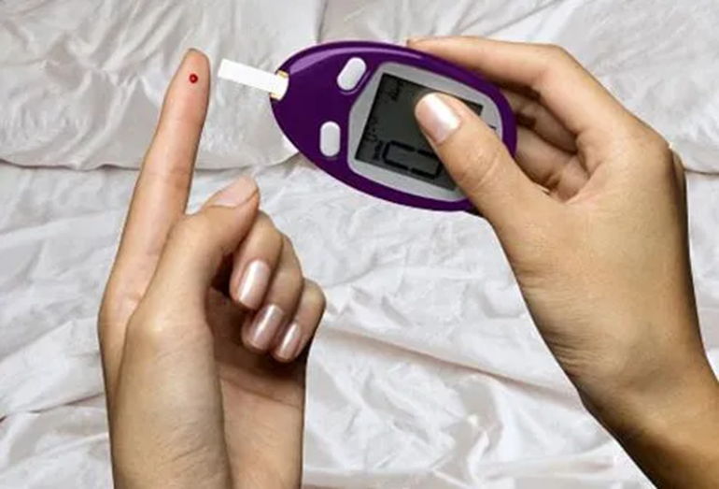
Caution: Sleep
To determine how blood sugar fluctuates during a typical 24-hour period it is important to test it regularly. Blood sugar can fall low during sleep for some people with type I diabetes; these people may benefit from a small snack just before bedtime. For other people, blood sugar can rise in the morning even before eating breakfast – this is due in part to changes in hormones or a drop in insulin levels. A good way to determine how your body utilizes glucose is to use a continuous blood glucose monitor on occasion. It can help you determine the blood glucose fluctuations that are normal for you.

Slide 20
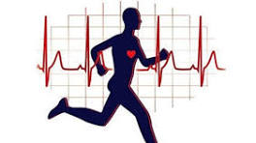
Rollercoaster: Exercise
Most clinicians agree that physical activity almost always can improve an individual's health, whether they have diabetes or have normal blood glucose levels. Unfortunately, when people with diabetes do intense or endurance types of exercise, their blood sugars may spike up and then drop for as long as 24 hours. People with diabetes should check their blood sugar before, during, and after exercises to be sure their blood sugar levels don't go too high or too low. Good blood glucose monitoring, coupled with appropriate treatments, can avoid this blood glucose roller coaster effect of highs and lows.

Slide 21
Rollercoaster: Alcohol
The same roller coaster effect of high and low blood sugar that occurs with exercise can occur when people with diabetes drink alcohol. At first, glucose levels may rise, but then they can fall and remain low as long as 12 hours after drinking. The roller coaster effect can be reduced if the person eats food when drinking alcohol. Alcoholic drinks can also contain a lot of carbohydrates. The American Diabetes Association (ADA) suggests a woman should drink only one alcoholic beverage per day, and they suggest no more than two per day for men. One alcoholic drink is equal to 5 ounces of wine, 12 ounces of beer, or 1.5 ounces of liquor (whiskey or vodka).

Slide 22
Rollercoaster: Heat
Being overly hot and sweating makes your blood sugar more difficult to control. Going in and out of air conditioning can have a roller coaster-like effect on your blood glucose levels. Staying in air-conditioned environments during the heat of the day and drinking plenty of water to avoid dehydration is a good way to avoid heat–related problems in controlling your blood sugar. In addition, people with diabetes should know that their medications, the glucose meter, and test strips could be affected by high heat such as the type of heat that can occur in a hot car or on a windowsill in the sun. Keep these items at room temperature.

Slide 23
Rollercoaster: Female Hormones
Another roller coaster effect of high and low blood sugar occurs due to hormone changes. Women's blood glucose levels fluctuate during the menstrual cycle and during menopause. Frequent blood sugar level tests can help people with diabetes manage this roller coaster effect due to hormonal changes. Your physician may provide hormone replacement therapy, but should discuss with you the risks and benefits of this therapy and how it may interact with your blood sugar levels.

Slide 24
Is Sugar Bad for You?
If you are a chocoholic and/or have a huge sweet tooth and have diabetes, you do not have to give these items up forever. The key is to understand that sugar compounds will increase your blood sugar levels more quickly than other carbohydrates, but the total amount of carbohydrate intake is most important. Consequently, if people with diabetes can keep a serving size small, they can enjoy their favorite foods as long as they take into account that the overall total carbohydrate intake and calories do not exceed their usual dietary levels. This means a small serving of sweets should be offset by eating other foods that contain no "sweets."

Slide 25
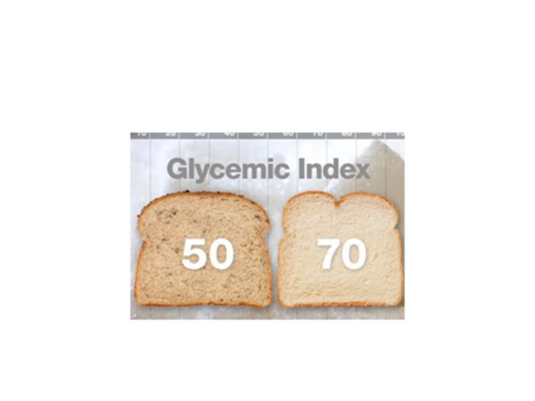
What About the Glycemic Index?
The glycemic index (GI) of foods is a rating of how individual foods raise blood sugar. The daily carbohydrate total is one way to manage blood glucose levels. Consequently, eating beans and whole grains that have a lower glycemic index than white bread or pasta can help keep blood sugars lower. So, if you want a small amount of high glycemic index foods (a small piece of pie, for example), it would be better to have the rest of the daily carbohydrate total made from low glycemic index foods. The ADA has glycemic index ratings and offers diet suggestions for people with diabetes. Refer to a glycemic index chart to pick foods best for your diabetes eating plan.

